Slide 1
Attending lessons on creating a mini company at school

Slide 2
This seminar organized by the environmental section of educational public office

Slide 3
The lessons and activities took place in the building located in the Technological Park of Lavrio

Slide 4
Only teachers took part to this course.

Slide 5
We attended lessons about healthy way of living, healthy food made from natural ingredients and how we could put all these subjects across to our students.

Slide 6
The scheduled lessons and activities lasted two days

Slide 7
A team of teachers taking part in Erasmus project learned about designing a logo for a company …

Slide 8
… and then we tried to put what we have learned into practice!

Slide 9
Teachers that have created and successfully run companies at their schools showed us how to make several products

Slide 10
We learned for example how to package olive oil in bottles …

Slide 11
…putting into oil herbs and many kinds of spices that give it a special taste!

Slide 12
How to make soap using natural ingredients…

Slide 13
and pour the mixture into molds in order to give them a shape

Slide 14
How to make traditional and healthy sweets like pasteli.

Slide 15
Here are some products we made there!

Slide 16
This training course gave us a lot of ideas. We have already put some of them into practice for our school mini company

Slide 17
We also had the chance to exchange experiences and ideas with teachers from other schools.

Slide 18
Learning about entrepreneurship

Slide 19
The technology teacher of 1st High School of Cholargos gave a presentation at school.

Slide 20
He tried to explain to the students the meaning of entrepreneurship, the advantages and disadvantages of having your own business.

Slide 21
Students participating in Erasmus project learned about basic principles of entrepreneurship…

Slide 22
and answered an evaluation questionnaire at the end of presentation

Slide 23
EVALUATION QUESTIONS
1. Young people and Businessmen nowadays: which ones do you Know?
2 Which sector have these businessmen excelled in?
3 Based on their sayings (interviews etc. )what do you think they owe their success to?
4 Innovative ideas with an impact: Report on ideas that have been put into practice or you expect to come out to the market.
5 Based on today's data (society needs, possibilities, etc.) if you had the chance, what kind of business would you start? Why?
6 If your parents wanted you to be their business advisors, what would you change to make it more competitive?
7 Which products-goods affect the consumer in your opinion (in terms of needs, advertisements, packaging, or something original)?
8 To change the market climate in Greece what kind of measures would you propose?
9 How do you like the business world initiative to give a helping hand to the country going through this crisis?
10 As businessmen which movement do you consider more important for your country: starting up a national business or a multinational/international one?

Slide 24
Students also took part in a meeting with an entrepreneur

Slide 25
He is a partner in a small company on olive oil packaging

Slide 26
He told students many interesting things about this company …

Slide 27
… how they choose the best olive oil from all over Greece, the machines and equipment needed for their company …

Slide 28
… about advertising and selling their products. He explained to the students that they had a lot of work to do in order to respond to the market needs.

Slide 29
He also added how to deal with their customers and how to calculate their expenses in order to have profit.

Slide 30
It was really a very useful meeting for students

Slide 31
EVALUATION QUESTIONNAIRE
ΣΑΣ ΠΑΡΑΚΑΛΩ ΝΑ ΑΠΑΝΤΗΣΕΤΕ ΤΙΣ ΠΑΡΑΚΑΤΩ ΕΡΩΤΗΣΕΙΣ
1. Τι εννοούμε με τον όρο επιχειρηματικότητα;
2. Μπορείς να αναφέρεις μια επιχείρηση στην οποία θα σου άρεσε να
δραστηριοποιείσαι;
3. Ποια είναι τα πλεονεκτήματα και τα μειονεκτήματα του ελεύθερου
επαγγελματία;
4. Ας υποθέσουμε ότι θέλεις να ανοίξεις μία επιχείρηση και αναζητάς συνεργάτες.
5. Ποια πιστεύεις ότι είναι τα χαρακτηριστικά ενός καλού συνεργάτη.

Slide 32
A competition for the logo of the project

Slide 33
The computer teacher explained to students what were the main characteristic of a logo and what someone should know to design a good logo

Slide 34
Students worked on groups …

Slide 35
They tried to design a logo

Slide 36
They also made some logos in the computer.

Slide 37
Many logos finally have been collected …

Slide 38
The Erasmus team decided which ones were the best ones

Slide 39
We put some of them on face book. Students voted through face book which of them they preferred …

Slide 40
At the end we have chosen this one as the logo for our school mini company.

Slide 41
The main theme of this logo is the owl connected with the ancient Greek goddess of wisdom Athena or her incarnation in Roman mythology Minerva. So this bird has been used as a symbol of knowledge, wisdom and education.

Slide 42
Activities at school

Slide 43
Planting a garden in a part of school yard

Slide 44
One of the main activities of project is creating a garden

Slide 45
We started by planting our herb garden

Slide 46
Students enjoyed learning about several kinds of herbs

Slide 47
They started ploughing the field

Slide 48
and mucked their garden

Slide 49
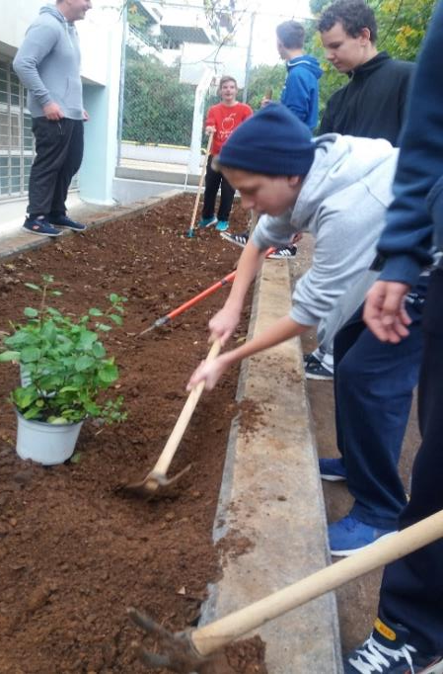
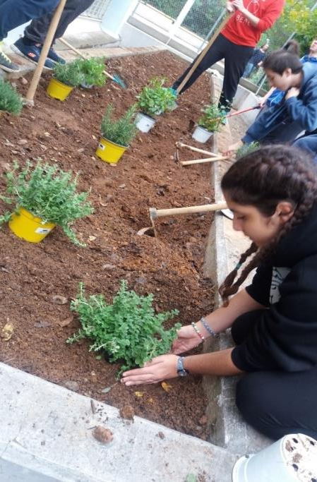
Then they planted rosemary, mint, spearmint, thyme, oregano

Slide 50
When they finished, they had to clean the access area

Slide 51
Every week they have to clean the garden and take care of it

Slide 52
Collecting almonds and using them in traditional sweets

Slide 53
Students picked almonds from an almond tree near our school

Slide 55
They collected almonds in a basket

Slide 56
They pealed them

Slide 57
They roasted in order to use in a traditional Greek sweet called kourabiedes (snow balls)

Slide 58
A couple of days before Christmas holidays a team of students conducted by the physics teacher prepared these sweets in the school kitchen.

Slide 59
They baked them and then they put on them some icing sugar

Slide 60
They offered them to the school headmistress …

Slide 61
and to other teachers singing Christmas carols …

Slide 62
… in the staff room

Slide 63
PRODUCTS FOR THE MEETING IN BAGHERIA We thought of preparing two kinds of sweets for presenting as products of our company : traditional sweets with almonds (amigdalota) and a very simple sweet with sugar and almonds

Slide 64
Amigdalota looks like kourabiedes but they have different taste

Slide 65
These sweets are usually made in many Greek islands

Slide 66
Students prepared them at the school kitchen …

Slide 69
Moreover, they prepared another sweet, easily made with almonds and sugar

Slide 72
They packed both of them

Slide 74
and add the school mini company logo

Slide 76
Products are ready

