Slide 1
SOME VERY INNOVATIVE IDEAS

Slide 2
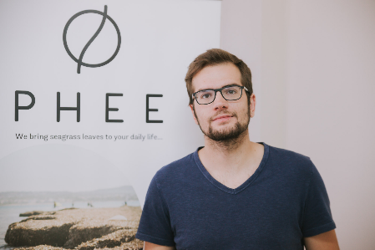
Stavros Tsompanidis PHEE

Slide 3
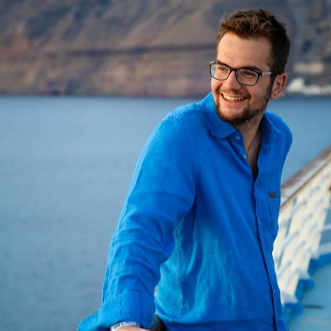
Biography
Stavros Tsompanidis studied Economics at the University of Piraeus. At the age of 22, he began working in various fields, such as organizing events and competitions, that encourage young people's entrepreneurship.

Slide 4
The idea
At the age of 20, while he was still a student in the Economics department at Piraeus University, Stavros during surfing the web accidentally fell into a video from TEDx and the speech of a well-known stratifier businessman who talked about the huge amounts of algae that are gathered on the beaches and end up in landfills when they could be used as raw material for the production of products.

Slide 5
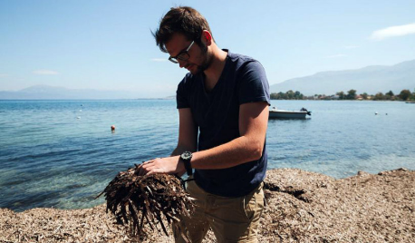
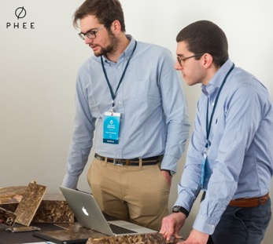
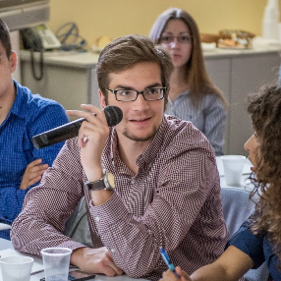
The company
He has founded the Phee company that recycles algae's by turning them into objects. He believes in the exchange of ideas with purpose to solve social and environmental problems.

Slide 6
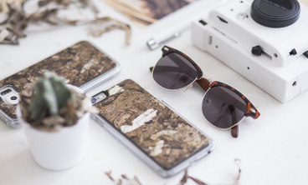
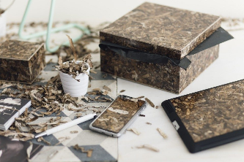
The products
PHEE products and markets a range of usable products coated with the multifunctional surface PHEEboard.
Cases for mobile phones, luxury packages, household items and sea rackets have already earned consumers inside and outside borders.
PHEE's latest creation is sunglasses. PHEEboard has additional applications in the furniture and interior decoration industry.

Slide 7
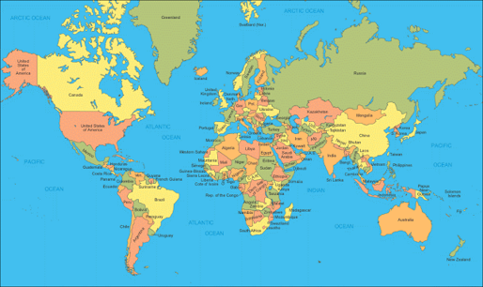
The company 'expansion
They have sent many orders to Spain and Luxembourg. The goal they have set is to be able to place their products in the Japanese and Scandinavian markets that are characterized by their ecological consciousness.
Next, will be the market in America. They have already talks with Greek-American investors and investors from London.

Slide 8
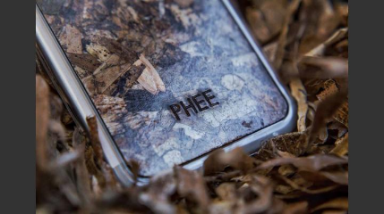
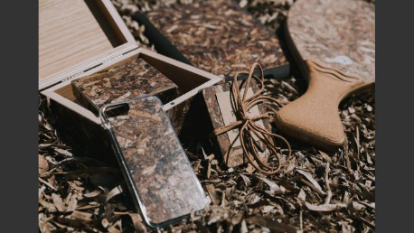
The awards of the company
In 2015 the PHEE team won a fellowship in the Angelopoulos-Clinto GIU Fellowship program, the second place in the Blue Growth Competition and the first in the ReditUp contest organized by Papastratos.
In 2016 she was awarded the Best Startup Award for Startup Company in Papastratos Startup Greece Awards.
The most impressive thing he and his company has accomplished is to be on the list “30 under 30” of Forbes.

Slide 9
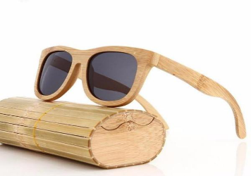
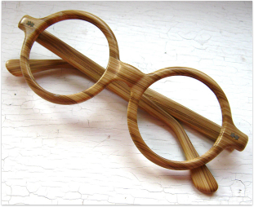
WOODEN GLASSES

Slide 10
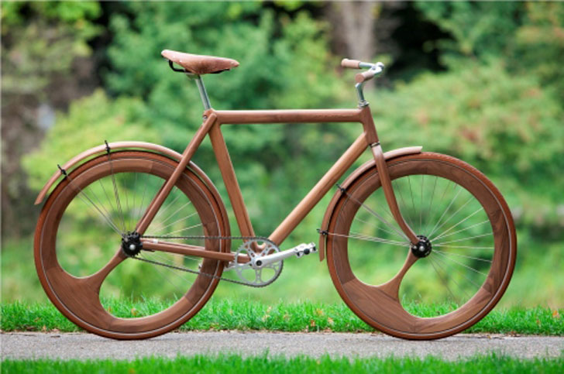
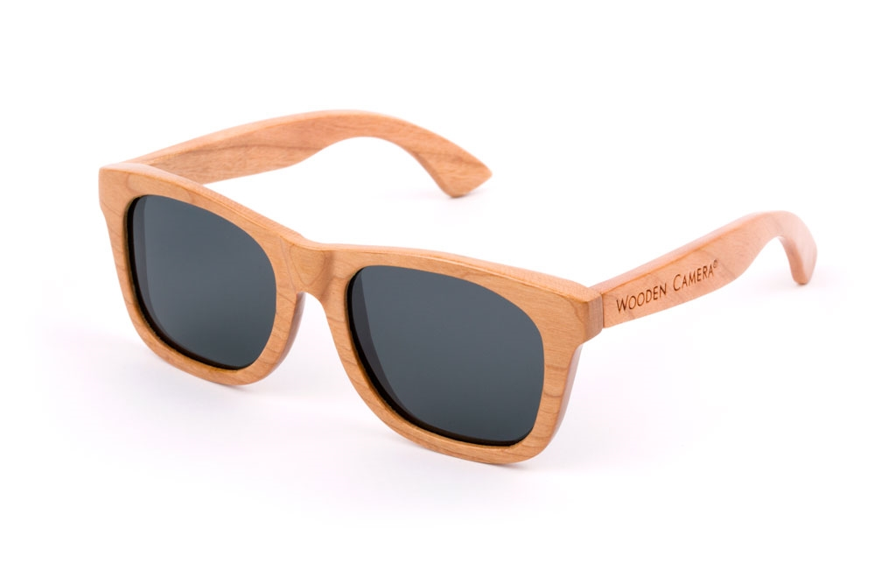
Some carpenters saw that their art was dying because of the economical crisis and changed their route into something more creative. Some of them decide to use wood in another forms like bicycles and glasses.

Slide 11
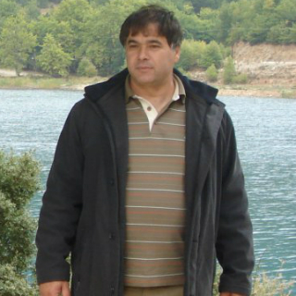
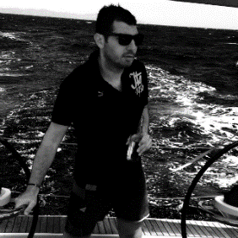
MARAGU
Maragu is a greek company established in 2014 which produces wooden glasses. The company’s designers are Thomas, George and Vasilis Katakis.
George Katakis Thomas Katakis

Slide 12
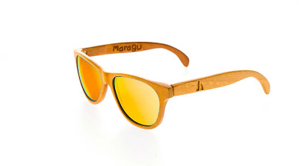
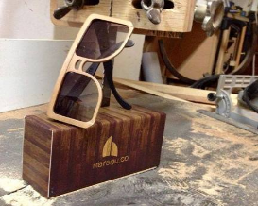
E-SHOP
They have become really popular in their field and they co-operate with a lot of European countries.
In order to meet their demands, they created an online shop where people from all around the world can purchase their sunglasses.

Slide 13
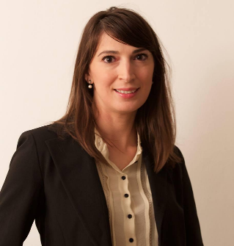
Maria Vlachou Breeding of snails

Slide 14
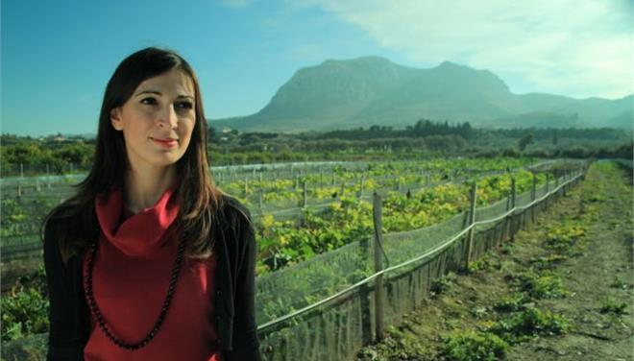
She was born in 1980. She speaks 9 foreign languages, she also holds a doctorate in comparative literature and many years ago she was invited by the University of Smirne where she taught Italian literature and later Greek at the department of Greek language and culture.

Slide 15
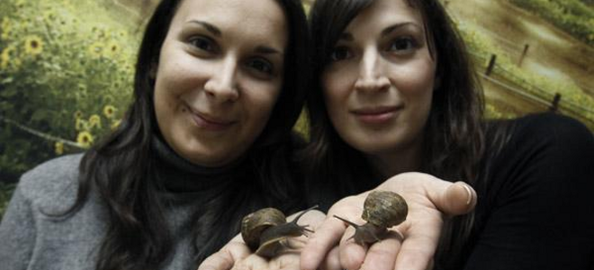
The idea
Later, she moved to Brussels where she was working as a translator in the European Economic and Social Committee. In Switzerland, she first tasted snails.
While she was eating she told to her sister: “I eat a portion of snails that costs 37 euros!” We have hundreds of snails in our garden. May we also take care of ourselves?”

Slide 16
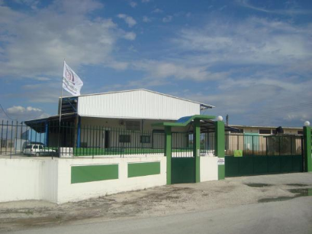
In the beginning…
Maria started with three acres and then the business expanded.
Now…
The industry has a tremendous future as the current world of production covers only 10% of the needs. The Vlachos sisters chose to expand with a network of collaborators throughout Greece.

Slide 17
IDEAS ABOUT HEALTHY FOOD

Slide 18
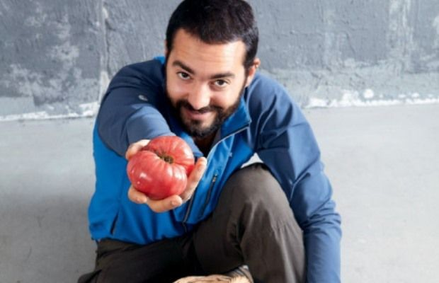
SOTIRIS LYBEROPOULOS exploring and collecting native food

Slide 19
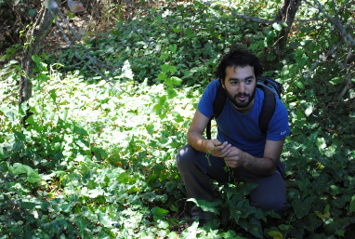
THE IDEA
At the age of 30, with a degree in economics, he left for a postgraduate in England and worked in a multinational on econometric models.
One morning, though, I woke up and wondered: "What do I want to do? Is this real life?". If I continued, I would stay forever, but something inside me wasn’t ok, “ he says.

Slide 20
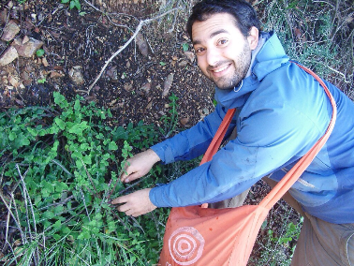
THE CONTINUE
He abandons everything and goes to his father's village in Raches, Messinia. He buys seeds, sows his estate, and lives only with what the earth is pulling out.
He decides that what he has done can be his profession as well. He picks up a list of award-winning chefs and tries to convince them that she can supply them with wild greens and garments that have nothing to do with what they buy.

Slide 21
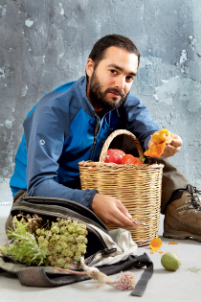
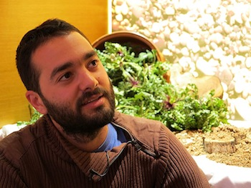
"Some thought they had nothing to lose. These were the people who opened my way when no one knew me’’, he says. ‘’So I started to discover things, to read, to ask. To learn about local varieties, to search the most strange seeds on the internet and to experiment,’’ she says

Slide 22
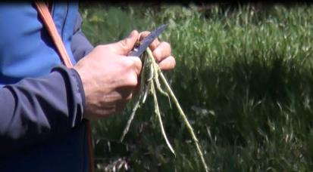
HIS COMPANY, ‘RADIKI’
sells grasses, olive oil, trachana and dried fruit in Greece, aiming to spread their activity on international markets.
collaborates with 12 of the most famous restaurants in Athens
90% of the materials used for the transport and packaging are natural and almost nothing is discarded
the packaging materials are collected and reused.

Slide 23
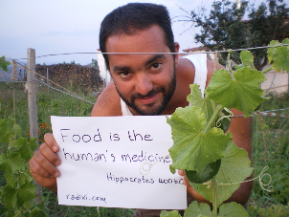
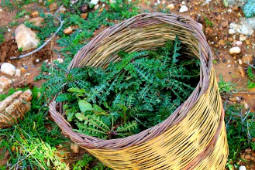
DISCRIMINATION
The recent Event of the International Business Week organized by Game Changers (ID-GC) gave a clear signal of development and positive energy.
The 5 live contests marked a total of 14 winners. In one of them, "Reinspiring Greece from the Youth UP" took the first place along with Family Farm, Radiki by Sotiris Lyberopoulos.

Slide 24
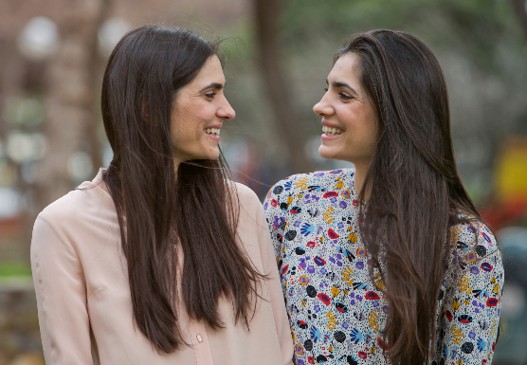
Martha and Kelly Xatzigianni Vital juices VERVE

Slide 25
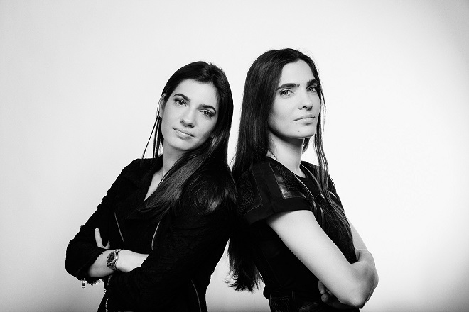
Biography
Both sisters had a career in Business administration and marketing but their love for healthy eating was enough to motivate them start something new.

Slide 26
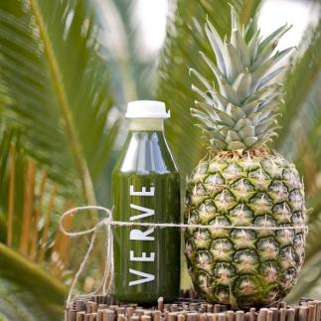
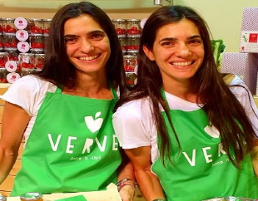
The idea
The main reason they decided to start their own business was the experience as young moms. They noticed that children's snacks of trade did not cover a child’s nutritional needs. They were high in sugar and preservatives.
There wasn’t in the market a fresh healthy juice without any processing and sugar that was packed but did not lose its nutrients. A juice for young and old, "explains Martha

Slide 27
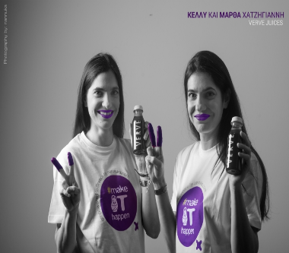
The beginning
The beginning was not easy. The product was familiar to them, but the creation of one's own company requires much more.
It took 8 months to prepare and take it to its final form.
Juicing seminars in London, research, collaboration with nutritionists for recipes
In January 2015 they created the first company in Greece to produce, bottle and dispense cold pressed juices

Slide 28
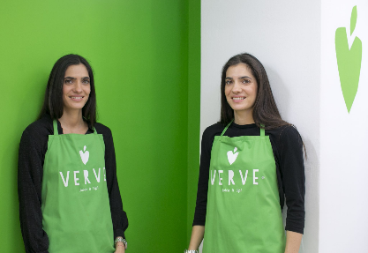
Now…
Today the company offers 12 juices in two sizes, depending on the season, 2 milks and a detox program. Verve's cold-pressed juices are made in their own area and distributed to customers and to dozens of outlets. They also offer detox programs to over 2,000 people and see their turnover double each year, and soon will test their strengths abroad.

Slide 29
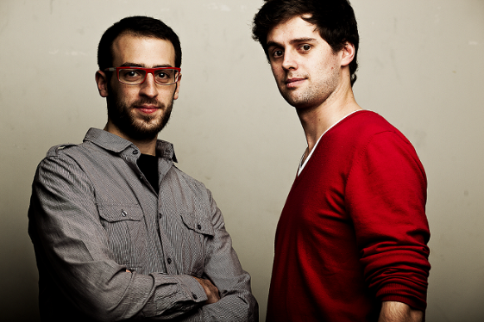
Michael Godas Peter Pitsilis Founders of Forky

Slide 30
What is Forky?
Forky is a fast-growing, catering business that has been fοunded in 2014. Through the Forky Internet platform and mobile application, users choose between two main dishes, a salad and various side dishes. Forky is a food-tech company that delivers thousands of meals per day in Athens. Every meal costs around 6€.

Slide 31
Their studies
Michael has a Business Administration degree from the University of Athens and he continued his studies at the Global Entrepreneurship Program (GEP) through which he attended a semester at EM Lyon Business School (France), Zhejiang University (China), and Babson College (USA).
Peter has a BA in Economics from La Sorbonne University and MSC in Management from EM Lyon Business School.

Slide 32
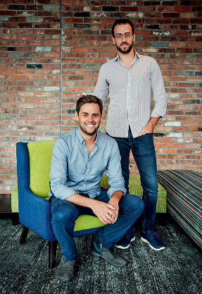
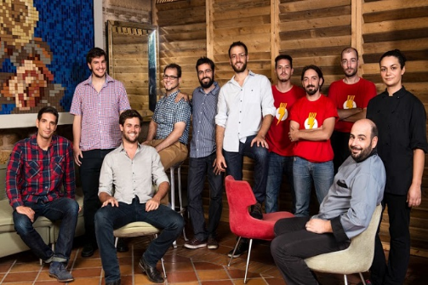
The idea
Michael and Peter share the same passion for food and technology so they decided to establish Forky.

Slide 33
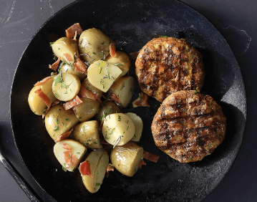
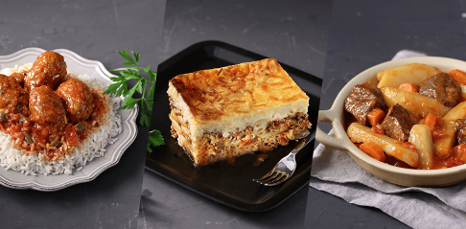
Some dishes from Forky

Slide 34
IS IT EASY TO FIND A GOOD IDEA?

Slide 35
Could you think of some factors or circumstances making somebody find a good idea ?

Slide 36
If you want to find out a good idea for your company, you have to:
stay curious.
keep your mind open to new ideas and embracing novelty.
Believe in yourself.
Start with something that you enjoy doing.
Be passionate with your idea.
Communicate with people that do things differently than you.

