Slide 1
HOW TO DEVELOP A SUCCESSFUL BUSINESS IDEA
Nina Pavlin, mag. Rosana Dular

Slide 2
INTRODUCE YOURSELVES
What's your name?
Where do you come from?
What are you good at?

Slide 3
BRAINSTORMING
What did you miss on this mobility?
or
2. What did you like on this mobility?

Slide 4
IDEAS ARE THE DRIVING FORCE FOR DEVELOPMENT
Helps you solve problems, because you know how.
Makes you find different paths, because you know how.
Makes you get better, because you know how.
Lets you help people, because you know how.

Slide 5
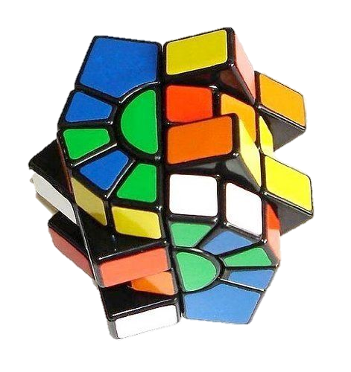
HOW TO GET AN IDEA?
Follow an example (Rubix cube).

Slide 6
HOW TO GET AN IDEA?
Combine different ideas (activity + rest = Active holidays)

Slide 7
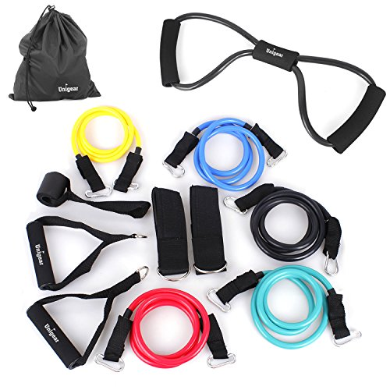
HOW TO GET AN IDEA?
Talking to people and listening
Solving problems, people have.
What is missing in certain area?
Recognizing holes in the market.

Slide 8
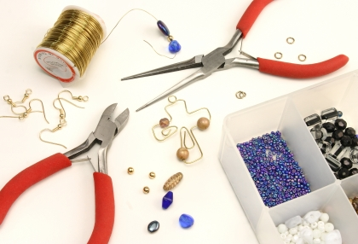
HOW TO GET AN IDEA?
Developing your hobbies.
Building on our skills.

Slide 9
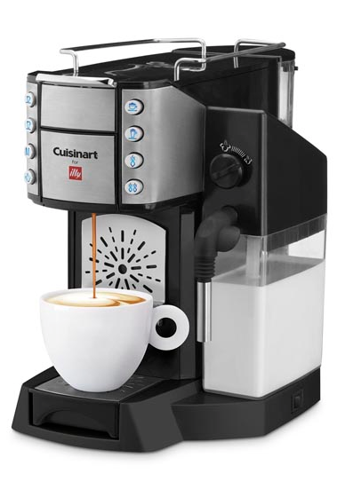
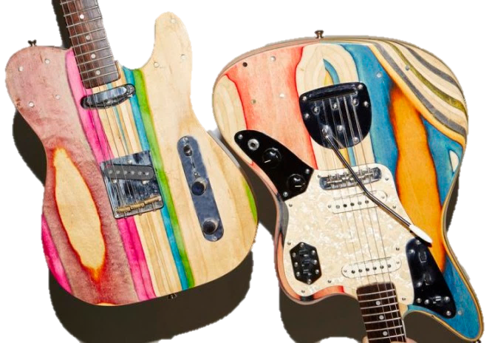
HOW TO GET AN IDEA?
Using recyclable resources
Finding new ways
(easier, cheaper, better, »better« design)
Improving products

Slide 10
HOW TO GET AN IDEA?
Ideas from travelling
Brain storming
Dreaming

Slide 11
WORLD CAFE
4 – 5 students sit at one table – make mixed groups.
One student is a HOST – the one with a flower on his chair.
The host stays at the table the whole time.
His job is to tell the newcomers about your previous work.
The host selects one problem or good thing from our brainstorming activity.

Slide 12
WORLD CAFE
How would you develop a business
from this problem or this good idea?

Slide 13
WORLD CAFE
Who would use or buy your product?

Slide 14
WORLD CAFE
What do you need for starting your business?

Slide 15
WORLD CAFE
Present your ideas.

Slide 16
QUESTIONNAIRE
Activities were useful. 1 2 3 4 5
The teacher was understandable. 1 2 3 4 5
The pace of the activities?
too slow just right too fast
What did you like best or find most useful about the workshop?
__________________________________________________________________
I felt
I suggest…
_____________________________________________________________________

Slide 17
IT'S NOT ABOUT IDEAS.
IT'S ABOUT MAKING IDEAS HAPPEN.

