Slide 1
BUSINESS DAY AT 1ST HIGH SCHOOL OF CHOLARGOS

Slide 2
18 JUNE 2017

Slide 3
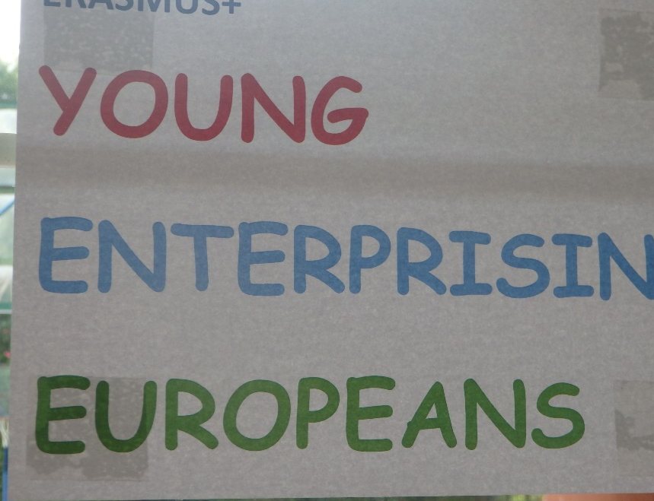
Preparing our stall in the central hall

Slide 4
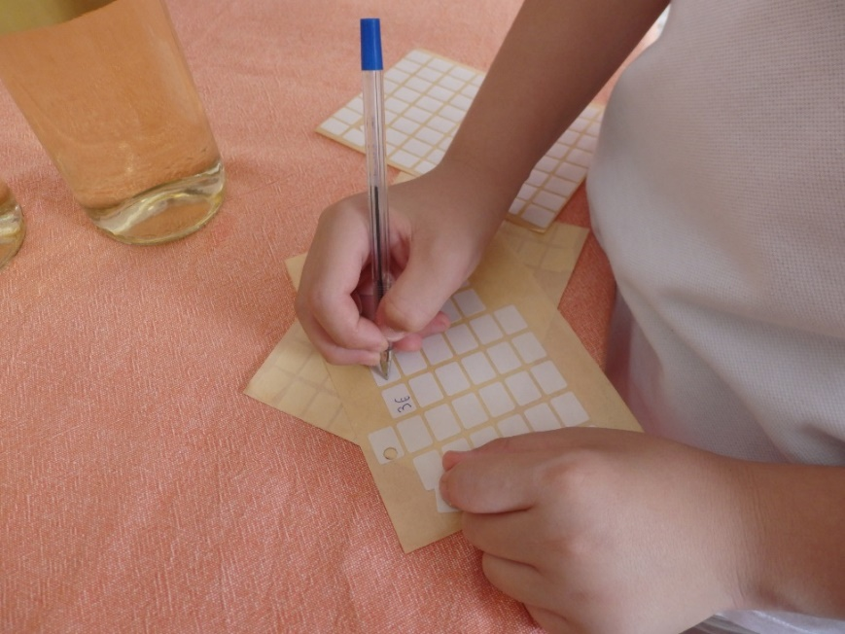

Slide 5
Our products of our school mini company

Slide 8
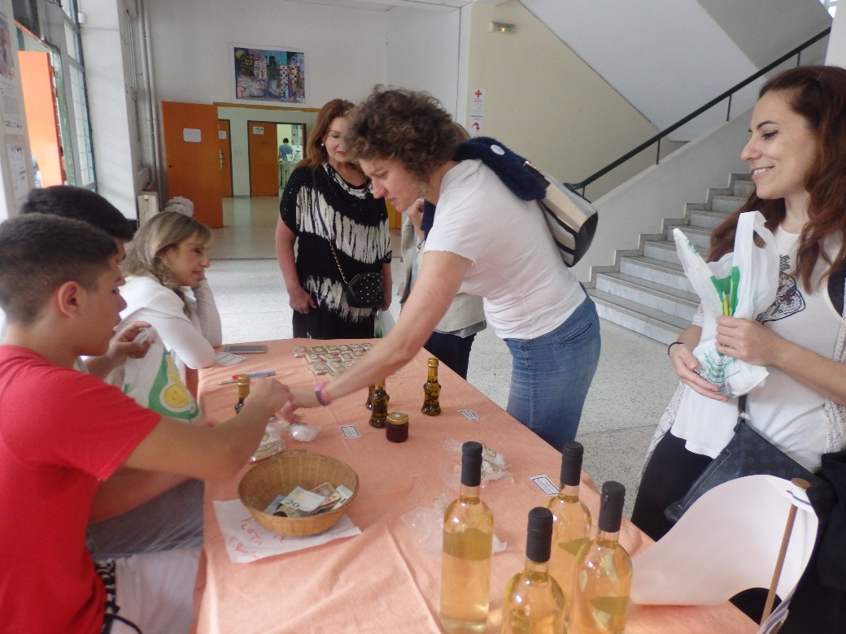

Slide 10
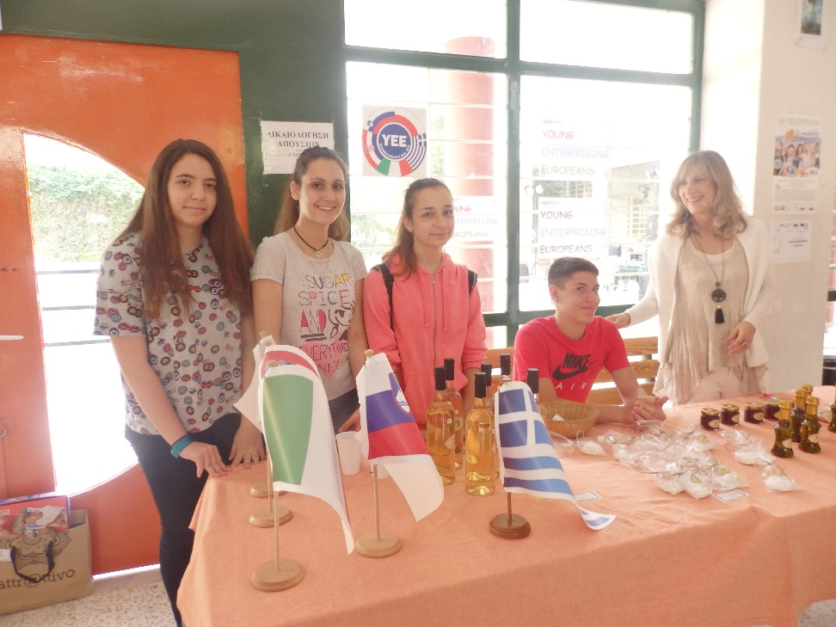

Slide 11
